Slide 1
Check in for Lab 2 and 3

Slide 2
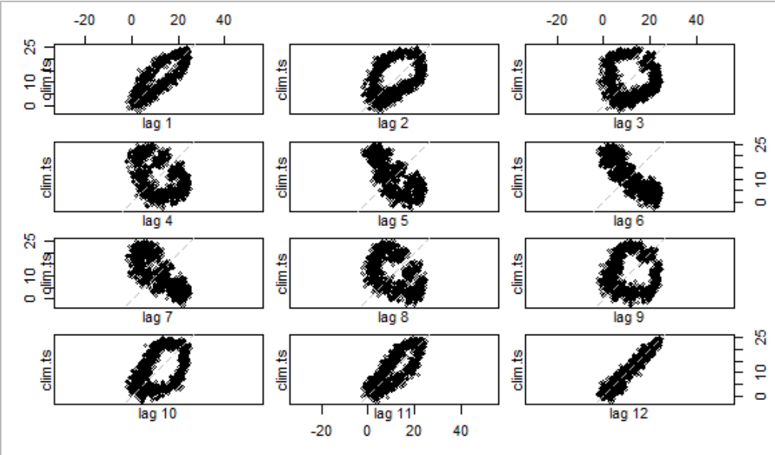
Check in for Lab 2 and 3

Slide 3
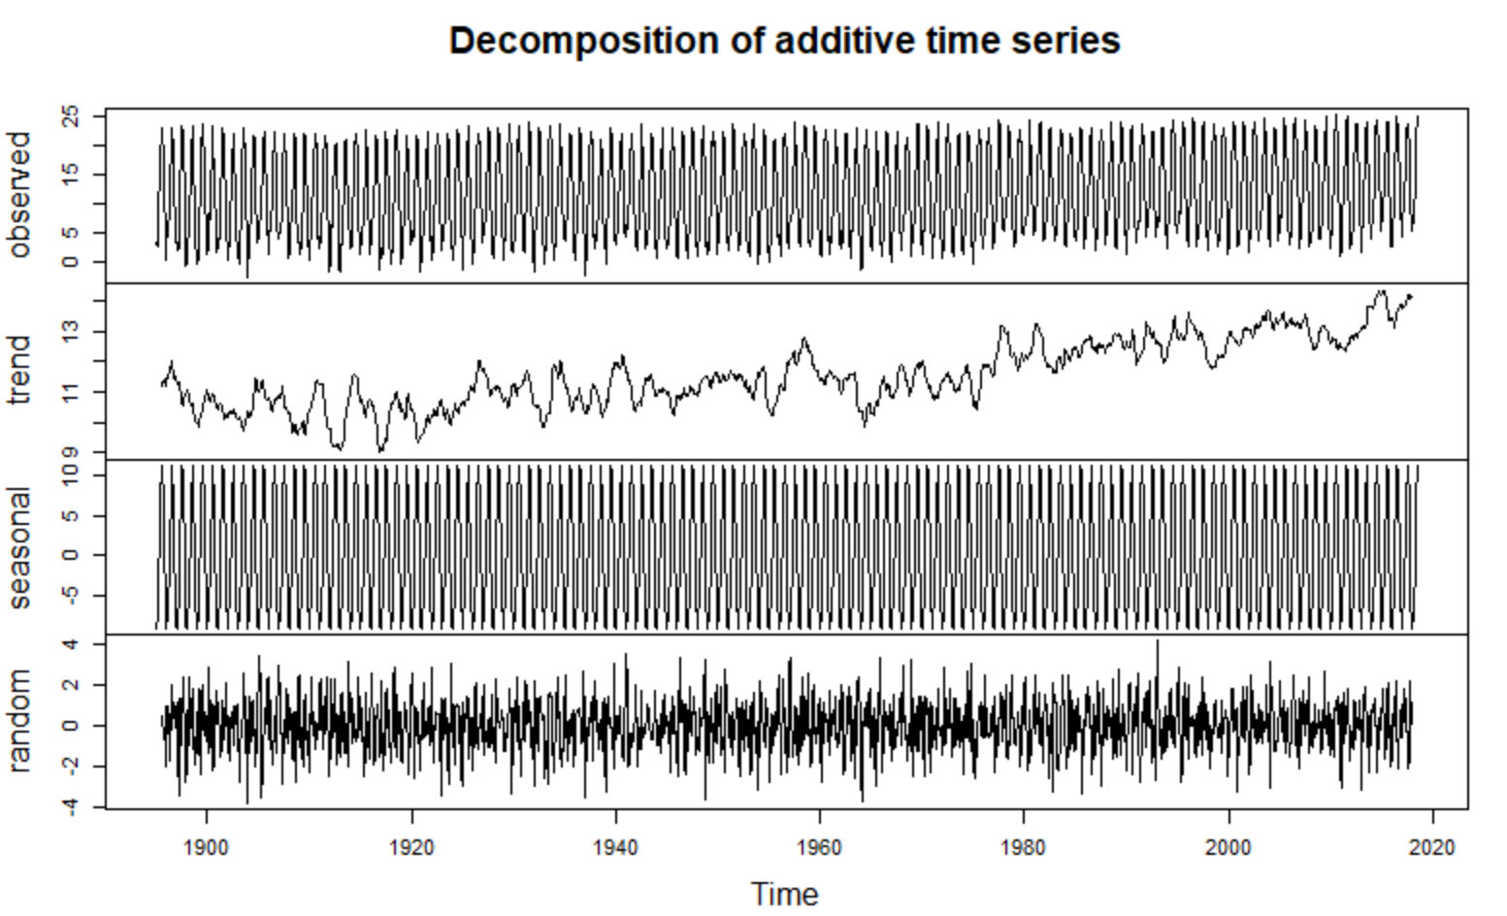
Check in for Lab 2 and 3

Slide 4
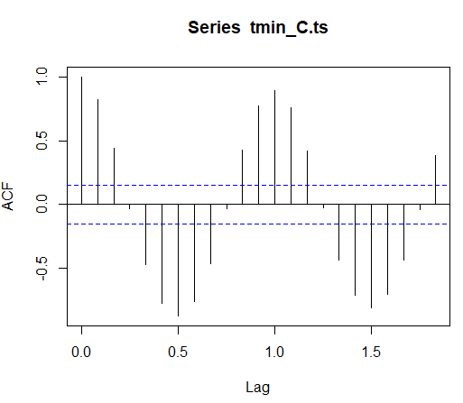
Check in for Lab 2 and 3

Slide 5
Check in for Lab 2 and 3

Slide 6
Check in for Lab 2 and 3
Shweta Gupta
Shweta Gupta

Slide 7
Benchmarking

